Slide 1



Slide 2
Welcoming Windows 10 Carl Schweitzer @carlschweitzeer
Notes:
What’s your it?
We all have an it—a business challenge that we’re struggling to move beyond.
Your it may be inhibiting your growth, stunting your productivity or clouding your communication. At Skyline, we’ll work with you to understand your unique situation and help you see beyond your it by blending smart business strategy with powerful custom technology solutions.

Slide 3
Skyline Overview
History
Founded in 1992 as a tech staffing agency
Evolved into a full service IT and marketing consulting firm
Associated Owned
Locations: Appleton, Green Bay, Milwaukee
176 Associates
25 Certified Scrum Masters (CSM)
2 Certified Scrum Practitioners (CSP)
50+ Microsoft Certified Professionals
Microsoft Partnership
Gold Certified Partner
2013 Azure Partner of the Year – Midwest Region
Microsoft Partner Advisory Council Member
Our Difference | Our People
Our it-qusitive people make a difference.
We ask why
We educate
We continually learn
We think strategically
We take the long view
We Are Hiring!
Explore our current openings today!
Stop by the Skyline booth or visit: SkylineTechnologies.com/Careers
Notes:
Promote that We Are Hiring! Direct attendees to the Skyline booth to speak to a Skyline associate or to our website for current openings.

Slide 4
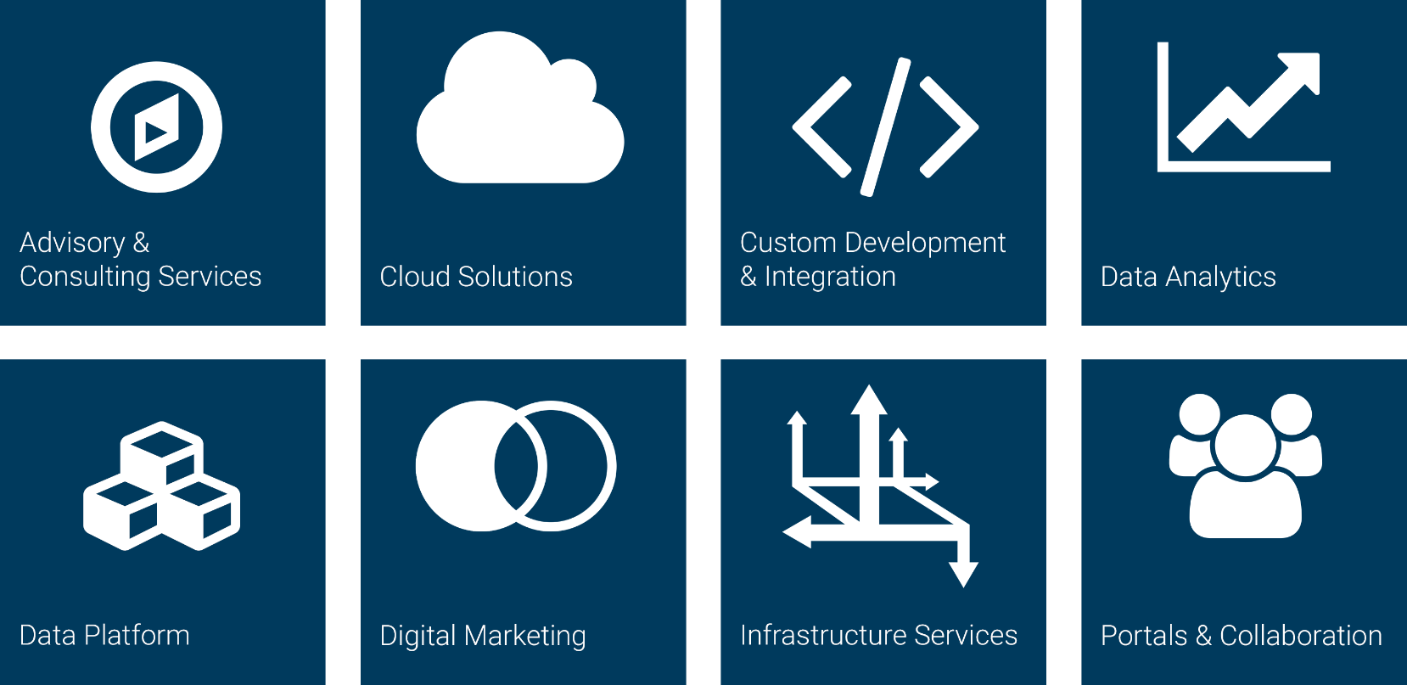
Competency Areas

Slide 5


Counselor Carl
First Year Counselor
Former camper
Senior Software Engineer
Microsoft MVP
Podcaster
Five Children

Slide 6

Welcoming New Campers

Slide 7

Welcoming Windows 10
Start Menu is back!
Cortana
Action Center
Notifications
Windowed Universal Apps
Virtual Desktops
XAML, XAML Everywhere!

Slide 8

Coding Windows 10
New layout options and Continuum
Windowed Universal Apps
Live Tiles
Miscellaneous APIs
Pivot
Copy/Paste
Drag n Drop
x:Bind

Slide 9

Investigating Windows 10 APIs further
Publisher Folders
App to App Communications
New Background Task capabilities
Hosted Web Apps
Interactive Notifications
Compositing
DirectInk

Slide 10


Q&A
https://github.com/caschw/WelcomingWindows10

